Slide 1
Building Resilience
Learning Experience: How Kindness and Safety Affect the Body

Slide 2
Check In

Slide 3
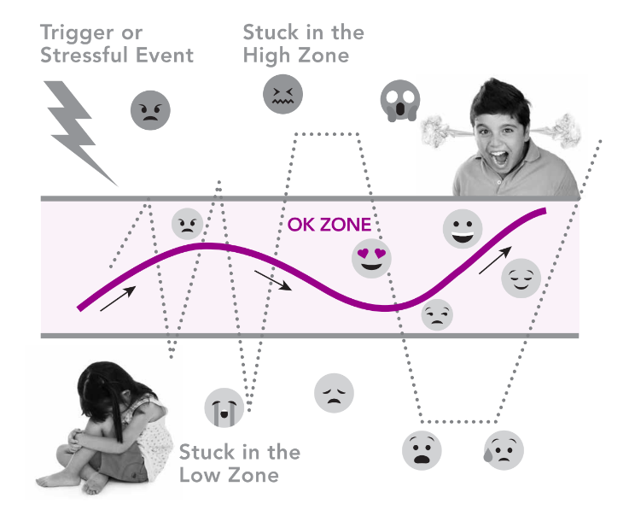
Presentation/Discussion
When we are in the resilient zone/OK zone, can someone show me what that may feel like in your body? Why?
What do you think happens inside our bodies when we are in our resilient zone/OK zone?
  Do you think it's healthy for our bodies to be in our resilient zone/ok zone? Why or why not?
What might we do that could help someone stay in the resilient zone/OK zone?

Slide 4

Insight Activity
Create a story based on the agreements made in class being followed or broken
Use made-up names for characters!
Any volunteer to act out the story?
“Go”=start the story
“Slow”= take a moment to notice sensation in your body
“The End!”= stop the story

Slide 5

Debrief
"What did you learn today about our class agreements?
How do our class agreements affect our bodies?
Is happiness something we feel inside the body? How do we know that? What about kindness?
Is there anything you think we should add to the class agreements after what we did today?
Is there anything you learned or practiced about kindness that you might like to use again sometime?

Slide 6

Visit us at SEELearning.emory.edu

