Slide 1
Building Resilience
Learning Experience: Grounding

Slide 2
Check In

Slide 3
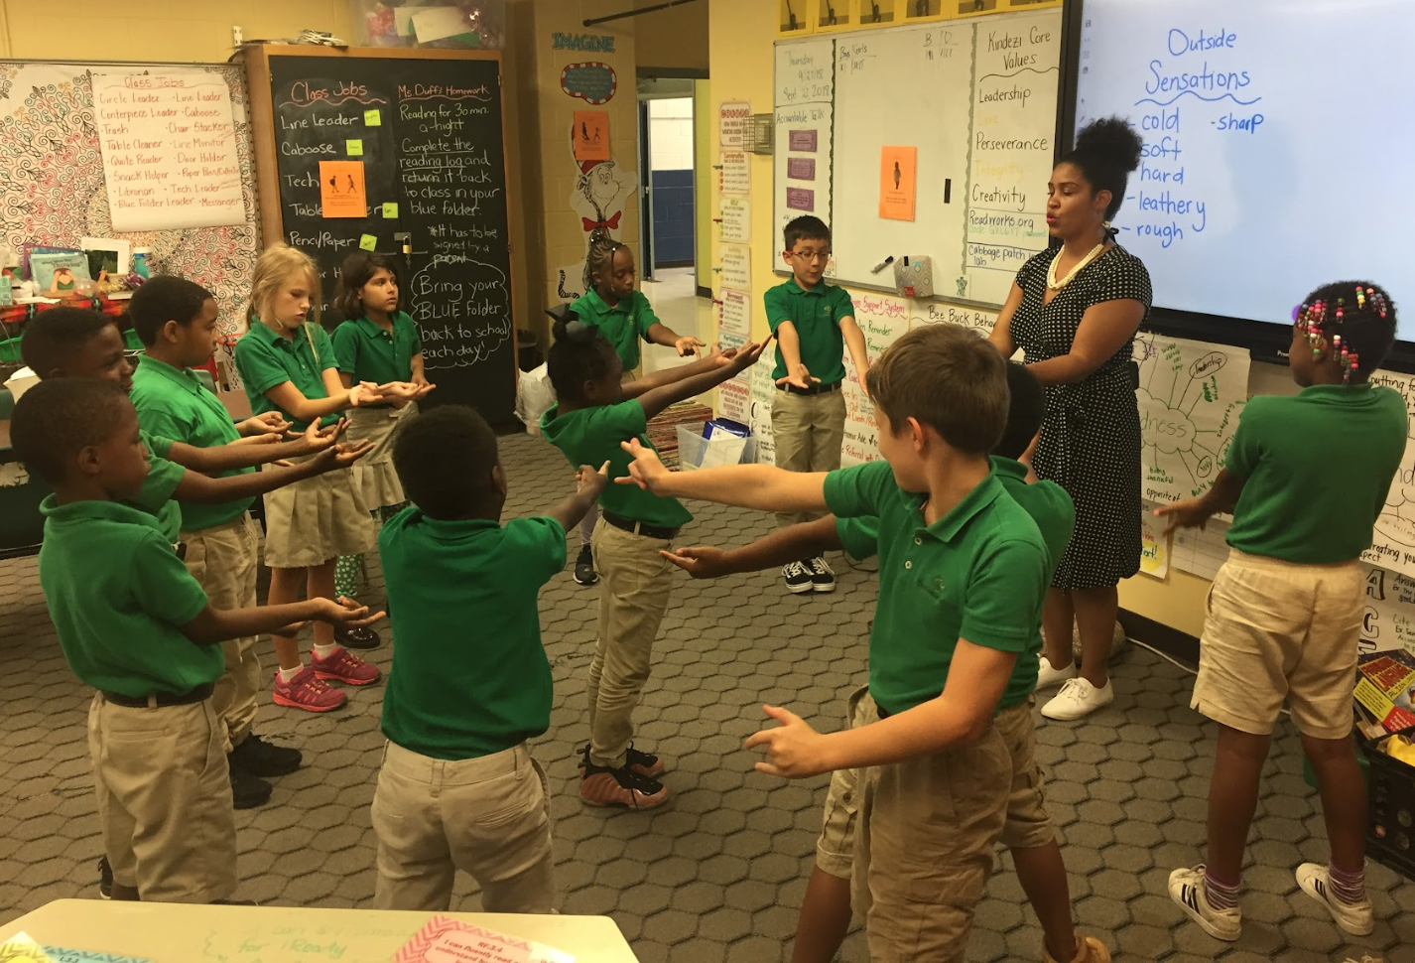
Grounding with One’s Stance
Do you feel better as you’re sitting or standing?
Do you feel better pushing against the wall? Or leaning against the wall? Or pushing down on a surface?
We can use this practice of grounding to help our body be calmer if it isn't feeling calm .

Slide 4
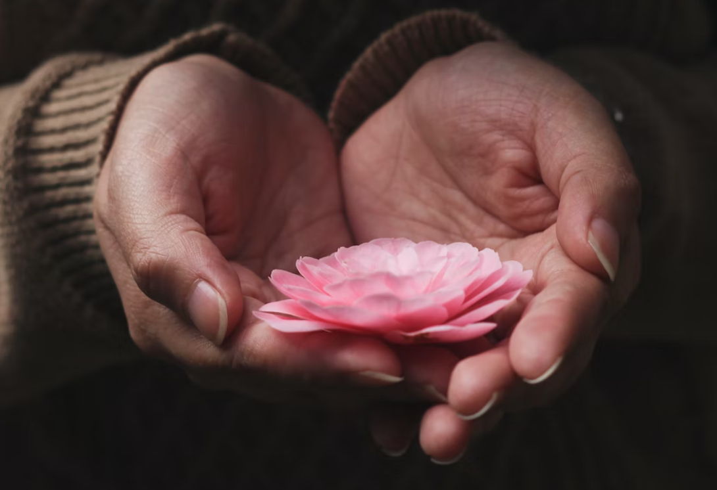
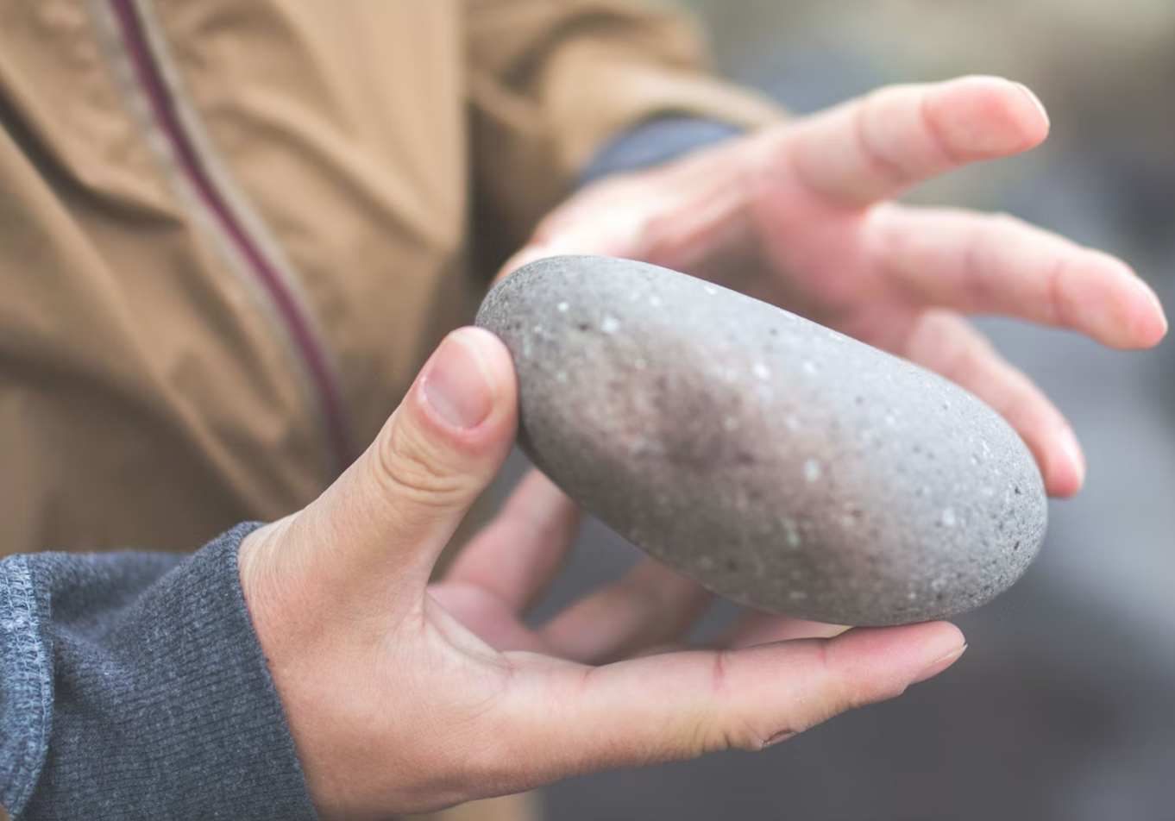
Grounding with an Object
Can anyone describe their object using sensation words?
What did you notice as we held our object? Where did you notice it in the body?
Notes:
Images free to use under unsplash license: https://unsplash.com/photos/PO1IOH18AVA (right pic) https://unsplash.com/photos/hECwQNeR1iE (left pic)

Slide 5
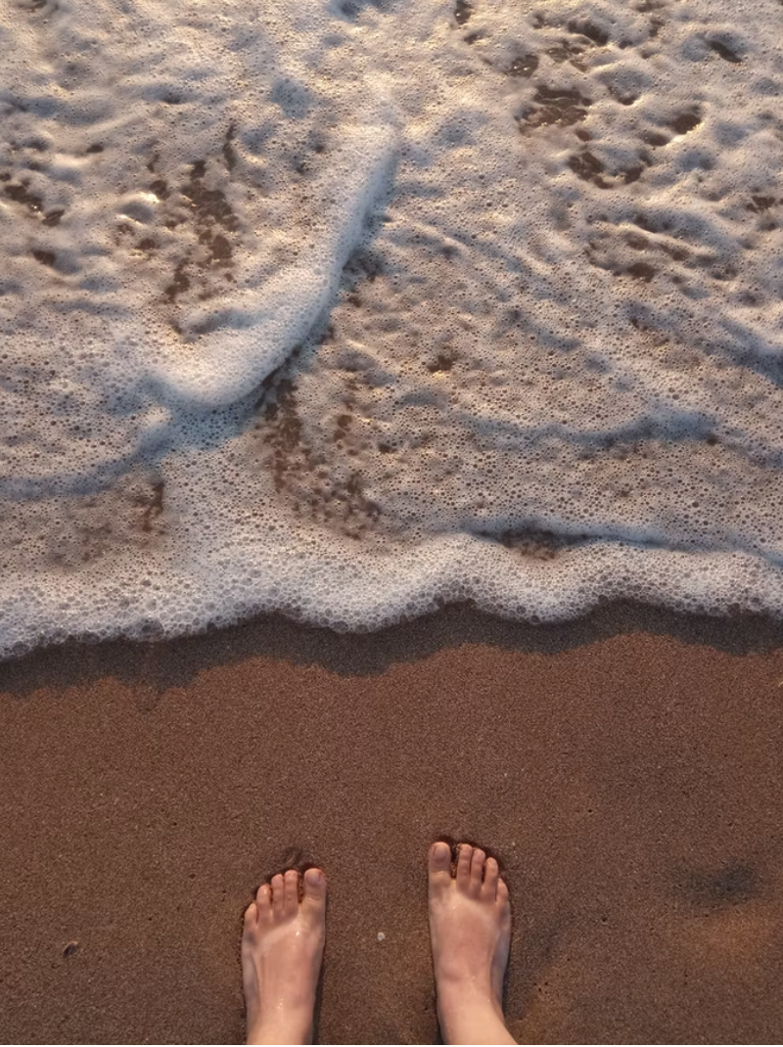
(Optional) Grounding with a Part of the Body
Let's try placing our hand(s) against a table, a wall or the floor.
Let's try paying attention to our feet and how they are positioned on the ground.
What did you notice?
Notes:
Image free to use under unsplash license: https://unsplash.com/photos/E265H9t8XnI

Slide 6
Debrief
Which has been the best grounding practice for you? Which one did not work for you?
Does anyone remember a sensation that they felt or heard someone else share?
When do you think you could use grounding?

