Slide 1
Building Resilience
Learning Experience: Creating a Treasure Chest

Slide 2
Check In

Slide 3
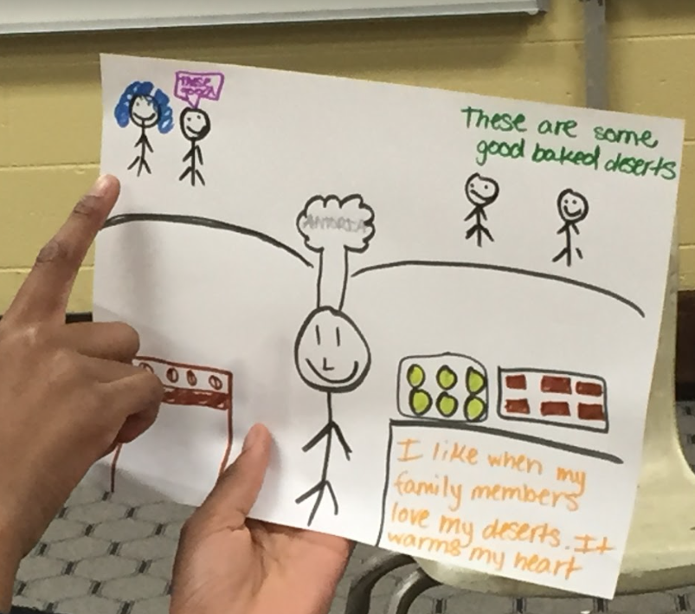
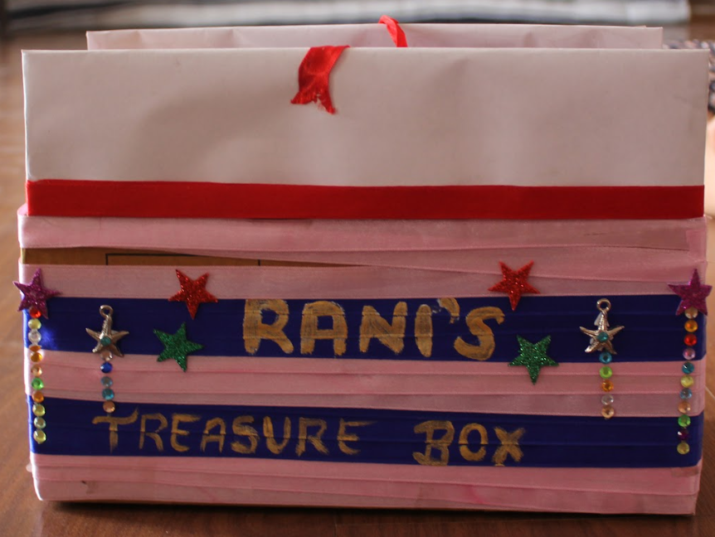
Creating a Treasure Chest of Personal Resources
Personal resources are things that make us feel good or happy or safe.
Is there someone you like who makes you feel safer and happier?
Is there a place you like that makes you feel better?
Is there something you really like to do that is fun?

Slide 4
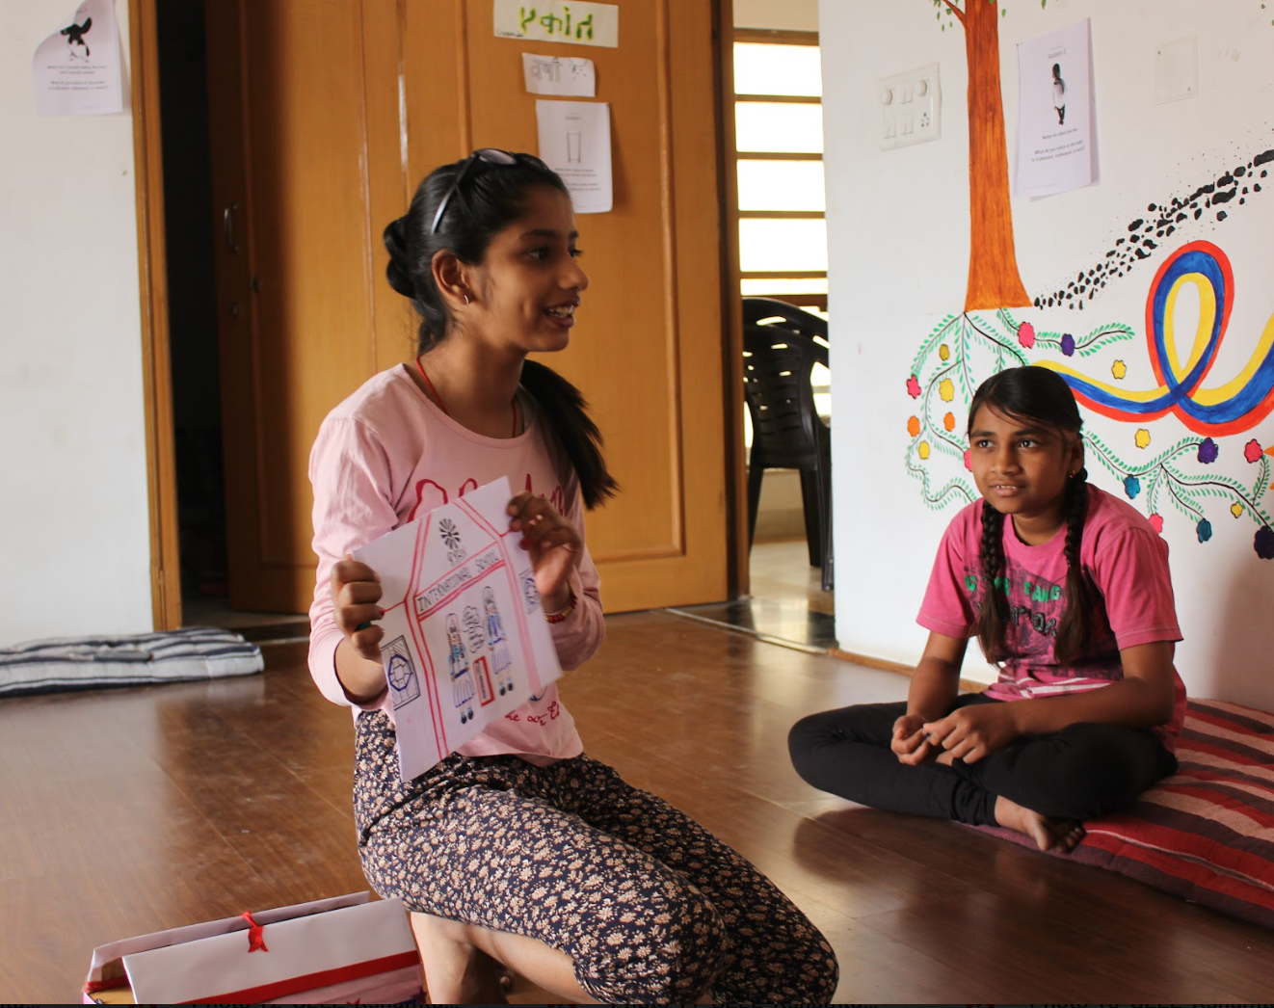
Practicing Resourcing and Tracking
What does it feel like on the inside when we look at and think about our resource?
When we notice the sensations in the body and pay attention to them, we are tracking.

Slide 5
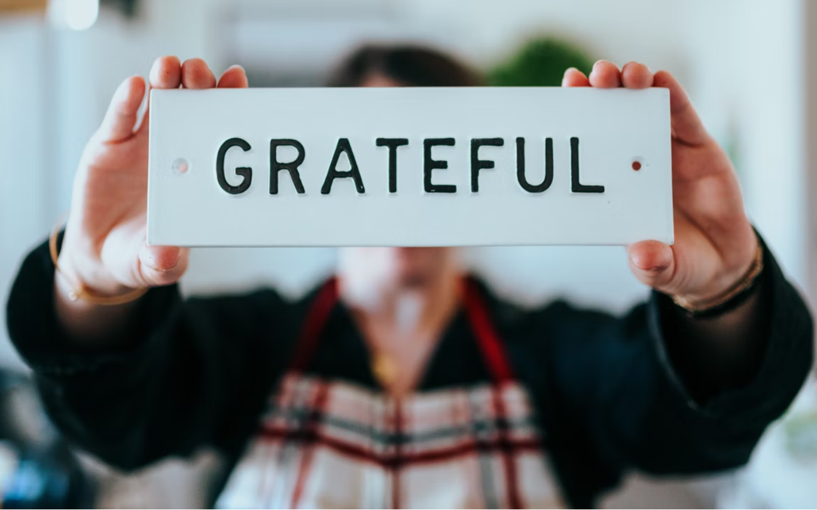
(Optional) Resource Stone
What sensations do you notice as you hold your stone and think of what you're thankful for?
Notes:
Image (copyright free) link: https://unsplash.com/photos/fs_l0Xqlc90

Slide 6
Debrief
What kinds of sensations came when we looked at our personal resources?
Do you think we could come up with more personal resources in the future?
When might you want to use your treasure chest?

