Slide 1
Recognizing Kindness and Exploring Interdependence
Chapter 1 Learning Experience 5

Slide 2
Check-In
Can anyone remember what we said kindness means?
Have any of you felt kindness today?
What was it like? If you can't think of a moment of kindness from today, you can imagine one if you like.
Take a moment to remember a moment of kindness by closing your eyes or using your imagination.
Can anyone share some of the acts of kindness that you thought of?

Slide 3
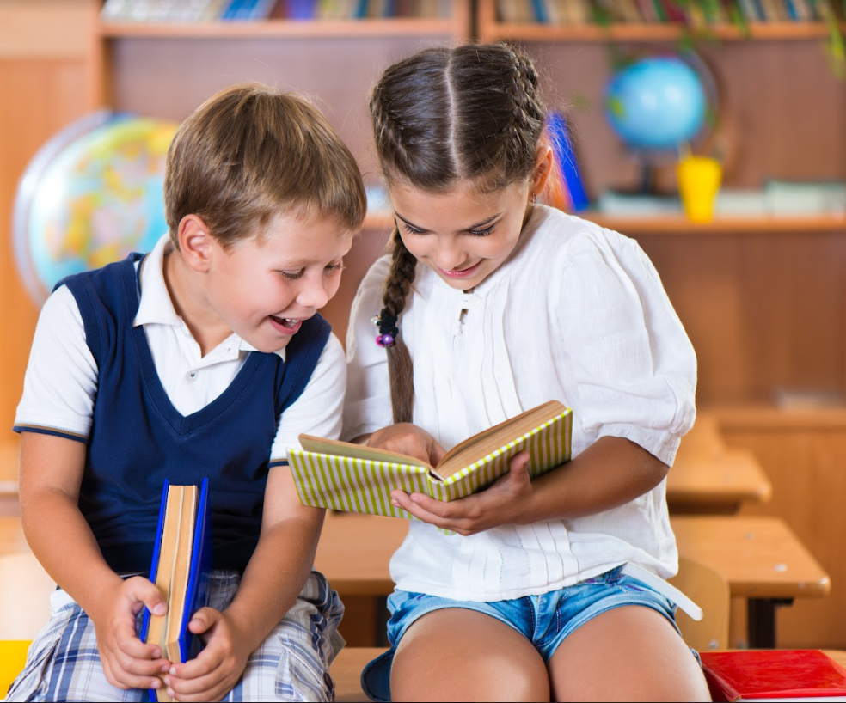
Insight Activity - Recognizing Kindness
How many "acts of kindness” do you think you encounter in a day?
Do you think there might have been acts of kindness that we didn’t even know about or notice?

Slide 4
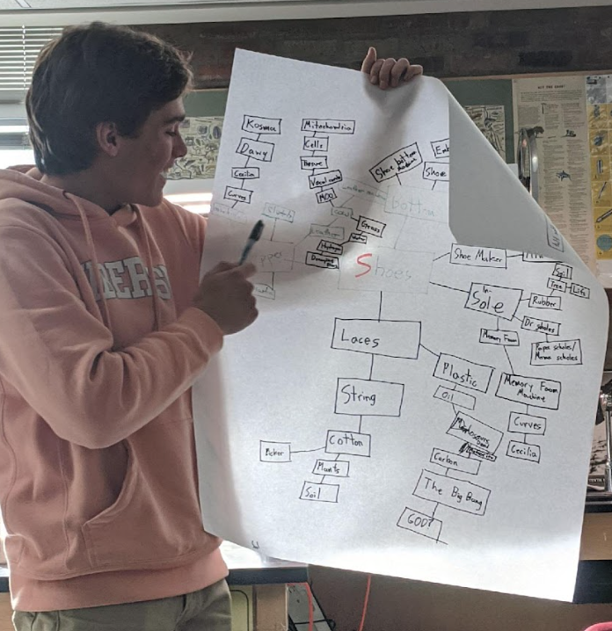
Insight Activity - Recognizing Interdependence
Draw an important accomplishment/event or object shared in common in the middle
Make a first circle by drawing anything the subject depends on
Make a second circle by drawing anything that the items in the first circle depend on
Keep making circles by identifying what any item depends on!

Slide 5
Insight Activity - Recognizing Interdependence
How many people in total are needed for your subject?
Count and add up the number of items on your paper!

Slide 6
Debrief
What do you notice about the web we made?
What does it feel like to think of yourself as a part of this web?
What does interdependence mean to you? What do you think about this idea?
How can we connect being thankful/grateful to interdependence?

