Slide 1
Creating a Compassionate Classroom
Learning Experience: Recognizing Kindness & Exploring Interdependence

Slide 2
Checking In

Slide 3
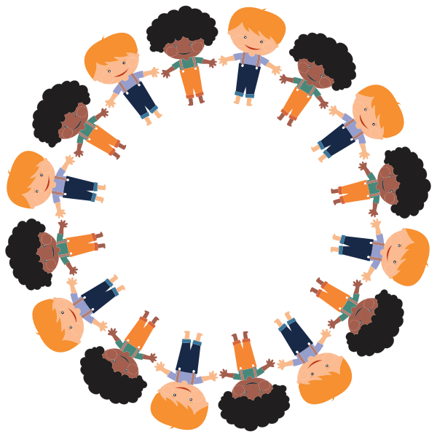
Recognizing Kindness
When I say something you like, Step In the Circle
When I say something you dislike step out of the Circle

Slide 4
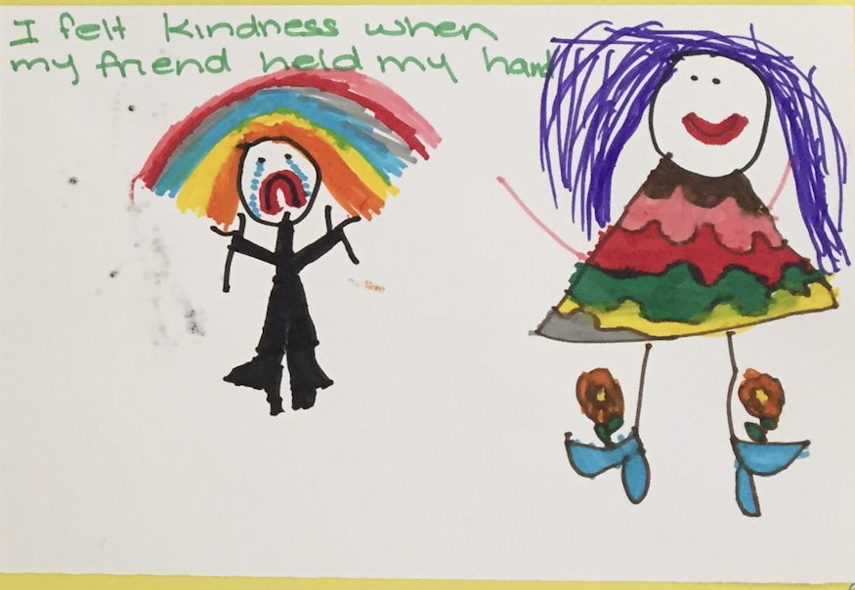
Remembering and Drawing Kindness
Imaging a time when someone was kind to you.
What did it look like? What did it feel like? What did you look like? What did you feel like?
Draw a picture of this memory

Slide 5
Debrief
Look at your personal web of interdependence or your group's web. What does it feel like to think of yourself as a part of this web? What do you think about this idea?
How might reflecting on interdependence lead us to feel grateful? How is interdependence related to kindness?

