Slide 1
Creating a Compassionate Classroom
Learning Experience: Kindness as an Inner Quality

Slide 2
Checking In

Slide 3
The Two Brothers and the Baby Swan
We all prefer kindness and want to move towards kindness.
Kindness makes us feel safer and more secure.
Kindness is an inner quality.
Pretend kindness (outward actions without a good intention) is not genuine kindness.

Slide 4
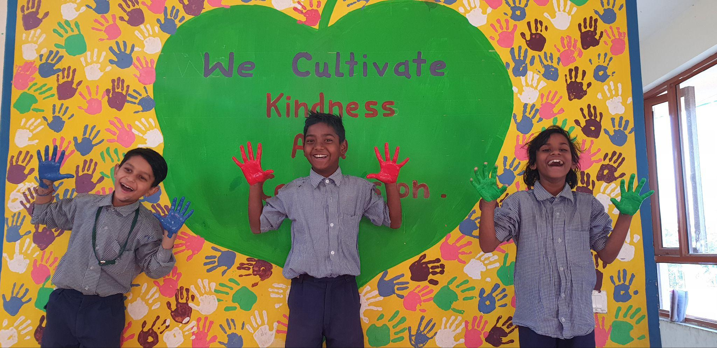
Reflective Practice
Silently think about the story and discussion. Think about the word kindness and what it means to you.
Come up with ideas and words that explain kindness. Write your ideas around the chart paper.
Write one sentence that defines kindness in your Learning journal.

Slide 5
Debrief
What is something you learned about kindness today?

