Slide 1
We’re All in This Together
Learning Experience: Life Together

Slide 2
Checking In

Slide 3
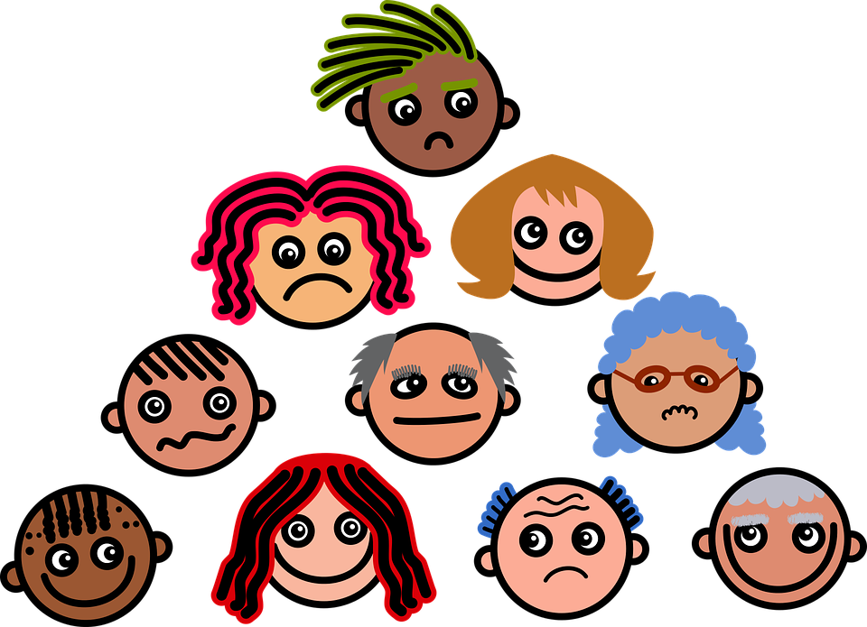
The Effects of Our Actions in a System
How do Kofi and Alice's actions might make the other students in the class feel? What might those students need? What might they do? What about their teacher-what might she feel, need, or do?
What needs are the same for these people? What feelings are the same for them?
Where are places people could intervene to help with this conflict?

Slide 4
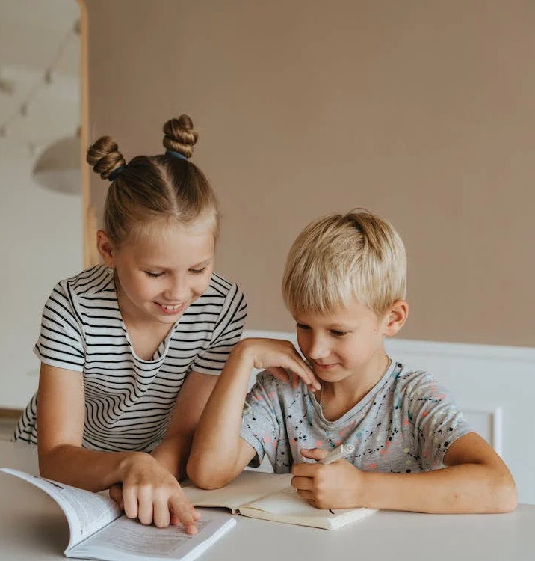
Reflective Practice
Pick a classroom agreement and draw yourself doing a helpful action related to that agreement. Draw another person who could be helped or affected by this action that you are doing.
How does that person feel and what might they do in return?
Draw anyone else you can think of who might also be affected by these kind actions.

Slide 5
Debrief
Everything we do has an effect; everything we say matters. The more thoughtful we can be in our actions and words, the better our impact on our systems can be! Think for a moment about someone in this room who helps you enjoy being a learner in this system.
In a moment, I'll ask you to give them a "thumbs up" or smile from wherever you are sitting. Thank them with your eyes for being caring about our system!
Ready, GO!

