Slide 1
It Takes a Village
Chapter 7 Learning Experience 1

Slide 2
Check-In
Comfortable and Upright Posture
  Keep eyes open or closed
  Choose a resource from your kit or think of a new one
Focus on Your Resource
  Bring it to mind and focus quietly
  Notice any sensations or feelings
Become Aware of Your Breathing
  Pay attention to your breath as it enters and leaves your body
  If uncomfortable, return to your resource or grounding
  If distracted, return to the breath or count your breath

Slide 3
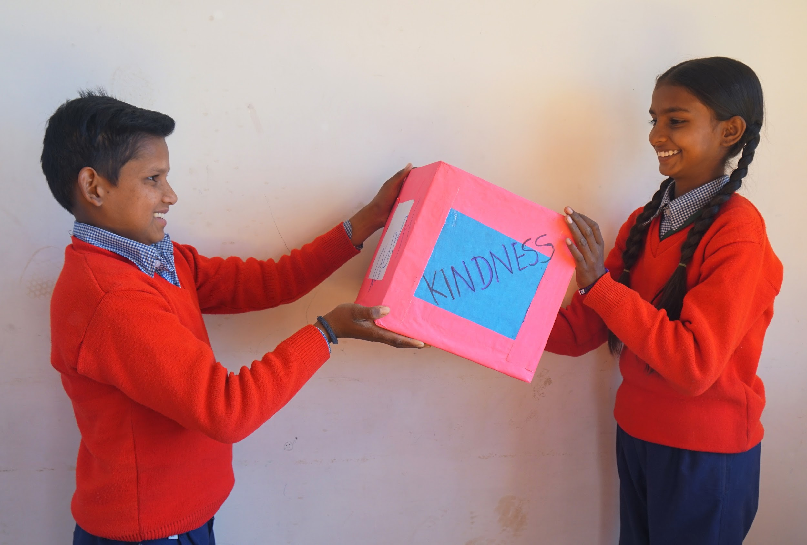
What is Caring and How Have We Experienced It?
What does it mean to "care" for something?
What are some examples of caring acts?
What are some of the reasons we care for something or someone?
How have we ourselves ever been cared for? By whom and what did they do?
Do you think you could count up how many people have cared for you in your whole life?

Slide 4
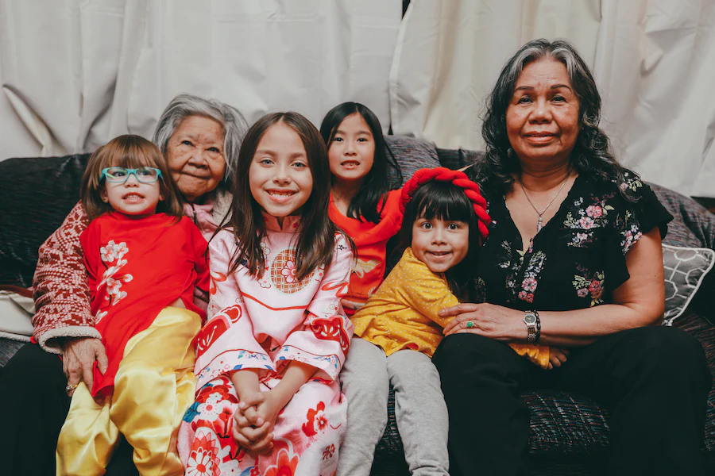
Insight Activity
Draw & label all the people that care for the child.
Write and draw all the things & experiences you can think of that are needed for the child to be provided for, protected, fed, clothed, and cared for.
What is expected back in return from the child for all of this care?

Slide 5
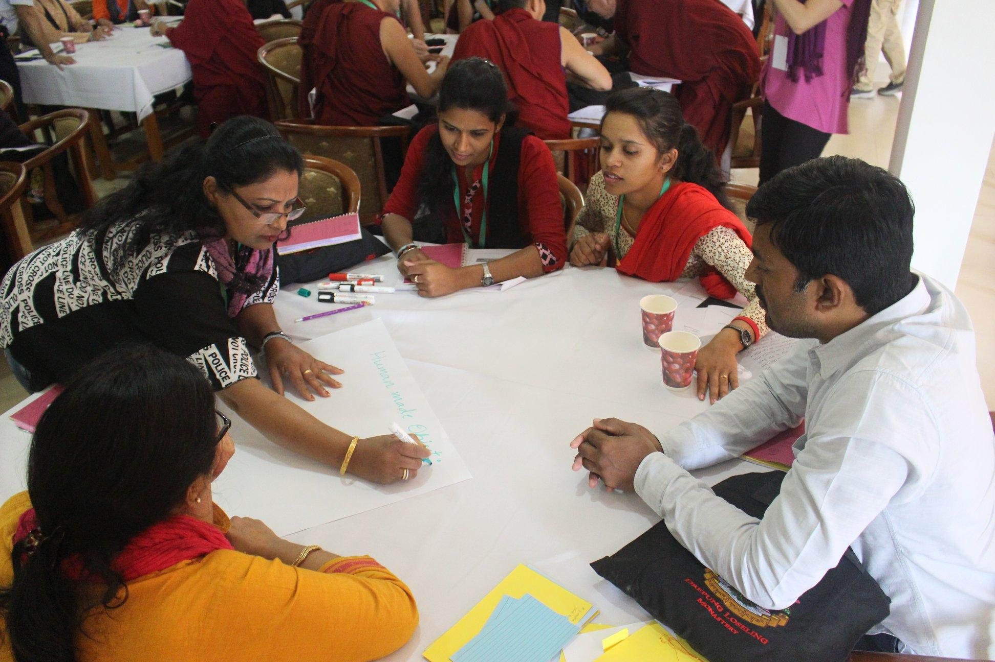
Reflective Practice
Write your name or draw yourself on the center of sheet of paper
Write/Draw all the people who have cared for you
How many people have provided care for you today?
How did it feel in your body while you did this activity? Did you feel any pleasant or neutral sensations?

Slide 6
Debrief
What was it like to think and talk about caring today?
How can you show caring and kindness throughout the rest of the day?

