Slide 1
Appreciating Diversity and Shared Commonalities
Chapter 5 Learning Experience 3

Slide 2
Check-In
Posture - Take a comfortable and upright posture.
Resource - Choose a resource from your kit or think of something that makes you feel better, safer, happier.
Focus - Bring your resource to mind and focus on it quietly for a few moments. You can also do grounding.
Internal Observations - Notice how you feel inside. Rest your mind on pleasant or neutral sensations, or shift to a better feeling place.
Breathing - Become aware of your breathing and focus on the sensation of the breath entering and leaving your body.
Return to Resource - If paying attention to your breath is uncomfortable, return to your resource or grounding.
Counting - You can also count your breaths if it helps you stay focused.
End Practice - Open your eyes and share aloud what you noticed during the practice.

Slide 3
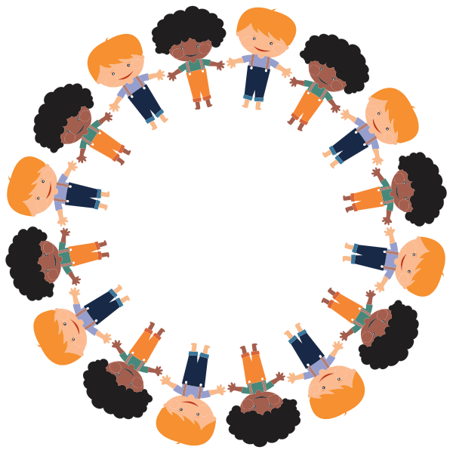
Insight Activity - Step In, Step Out
If I say something that’s true for you, then you’ll take one step forward, into the circle.
If what I say doesn’t apply to you, just remain where you are. This time, I’d like you to pay special attention to who steps into the circle when you step in. See if you can pay attention and remember.
In what ways are we different?
In what ways are we the same?

Slide 4
Insight Activity - How Are We the Same? How Are We Different?
Let’s name some ways in which most people are the same.
Now let’s name ways in which people are different.
Is this something that everyone in the world has in common?
Are there other ways we can be different that we could add to this second list?

Slide 5
Debrief
Were you surprised by any of the things that were the same for all of us? What about differences?
How might it be helpful for our class to know how we are the same and how we are different?
Could knowing about this help us to be kinder and more compassionate to each other? How or why?

