Slide 1
Learning About and From One Another
Learning Experience: Understanding Others Emotions in Context

Slide 2
Checking In

Slide 3
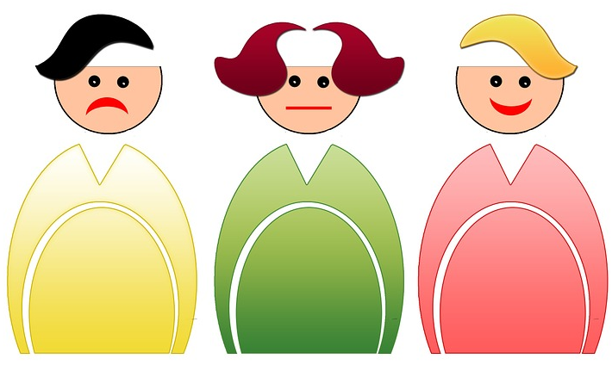
Albert and Alice See a Dog
What was Alice feeling in the story? Why do you thinks she was feeling that way?
What was Albert feeling in the story? Why do you thinks he was feeling that way?
Why do you think Alice and Albert had different feelings to the same dog?

Slide 4
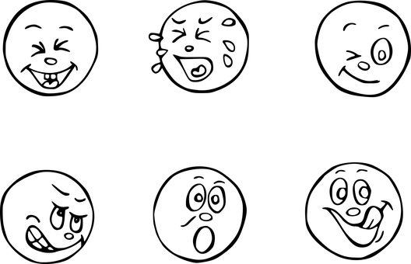
We can Experience Things Differently
Imagine a time when you were very excited about something.
Draw that moment and include friends and family members. Include at least one person who is not excited about the same thing.
Who would like to share what is happening in their drawing?

Slide 5
Debrief
When something happens, like Albert and Alice seeing the dog, why do you think we sometimes feel the same way but sometimes we feel differently to each other?
If someone is feeling differently to us, what questions could we ask them to make sure?

