Slide 1
Navigating Emotions
Learning Experience: Emotional Hygiene

Slide 2
Checking In

Slide 3

What is Emotional Hygiene?
Recall “Creating Emotions Families” Activity.
What risky emotions might Nelson be experiencing in our story?
What strategies can Nelson use to handle those emotions?

Slide 4
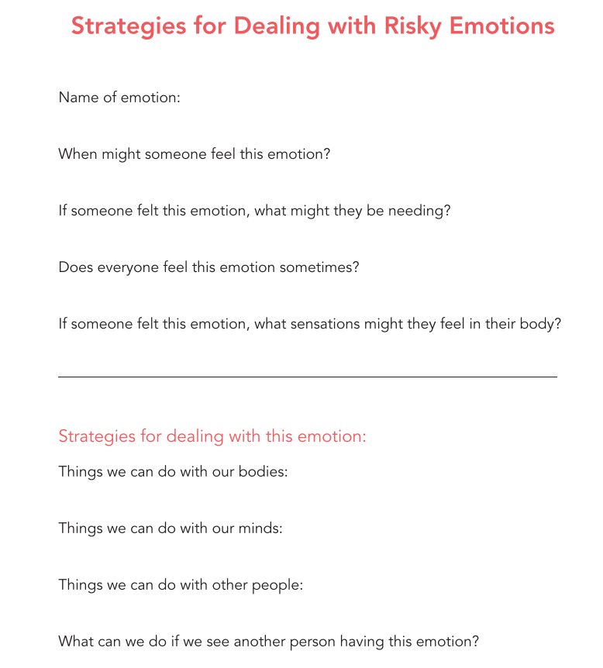

Slide 5

What Can I Do When I Feel A Strong Emotion?
Choose another risky emotion from the Emotions Families Chart.
What strategies can help someone like Nelson with this emotion?
Draw a picture of Nelson using these strategies.

Slide 6
Debrief
Why do you think emotional hygiene might be useful?
How might we get better at emotional hygiene?

