Slide 1
Creating a Compassionate Classroom
Learning Experience: Exploring Kindness

Slide 2
Checking In

Slide 3

Investigating Risky Emotions
Happy
Kind
Sad
Angry
Afraid
Joyful
Excited
Content
Pleased
Caring
Loving
Friendly
Empathetic
Lonely
Gloomy
Miserable
Frustrated
Impatient
Annoyed
Worried
Scared
Nervous

Slide 4
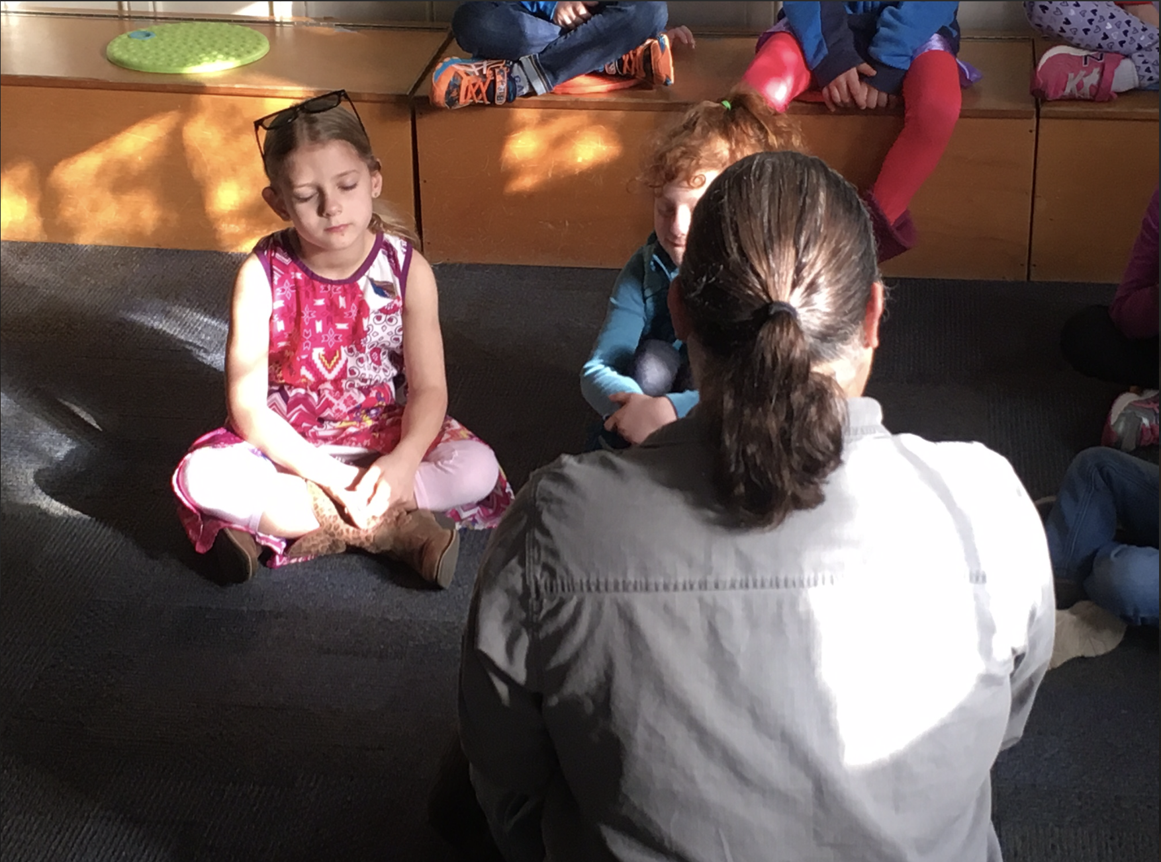
Observing the Mind for Emotions
Let's think of one of our resources in silence, perhaps think of a favorite person or thing.
Let's focus on our breath now.
Now, we're just going to watch to see whatever comes up in our mind.
What did you notice? Could anyone watch thoughts coming and going? What was that like?
Did anyone notice a feeling or emotion?
Do you think you'd be able to notice emotions if they happened during the day?

Slide 5
Debrief
What did we learn about risky emotions?
How do we know if an emotion is risky or not?
What might happen if we noticed risky emotions quickly?
Have we learned anything that could help us notice risky emotions?

