Slide 1
Navigating Emotions
Learning Experience: Personal Needs

Slide 2
Checking In

Slide 3
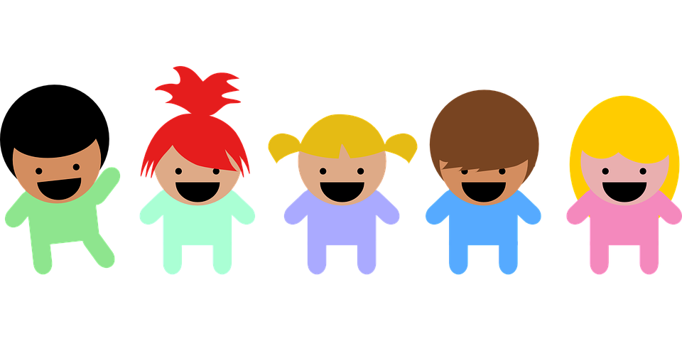
Feelings and Needs of a New Student
Nelson is a new student.
What needs might Nelson have if he is shy?
How would he feel if those needs were met?
Think of a time you joined a new group and your need for friendship was met. How did it make you feel?

Slide 4

My Needs
Choose a need that is really important to you. It can be from the needs list we created earlier.
Draw a picture that shows you and other people meeting your need or helping to meet your need.

Slide 5
Debrief
When we see other people, how might we come to know what they need?
When we see other people having strong feelings, could we think about what it is that they need?

