Slide 1
Navigating Emotions
Learning Experience: Exploring Needs

Slide 2
Checking In

Slide 3
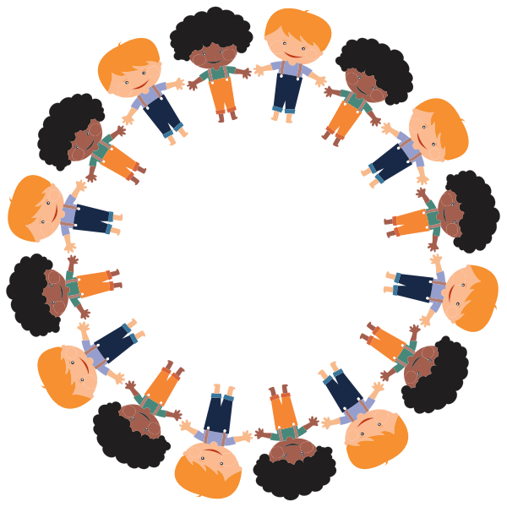
Shared Needs
What do we need to be happy?
What do we need to live?
What do we need in order to learn?

Slide 4
Debrief
"Can anyone think of a time when a family member, friend, or teacher noticed what you needed and helped you get it?
How does it feel when other people (family, friends, teachers) notice your needs and help you get what you need?
Have you ever noticed needs that other people have in common with you?
What would happen if we all noticed each others' needs more?"

