Slide 1
Strengthening Attention & Self-Awareness
Learning Experience: Cultivating Attention in Activities Part 1

Slide 2
Checking In

Slide 3
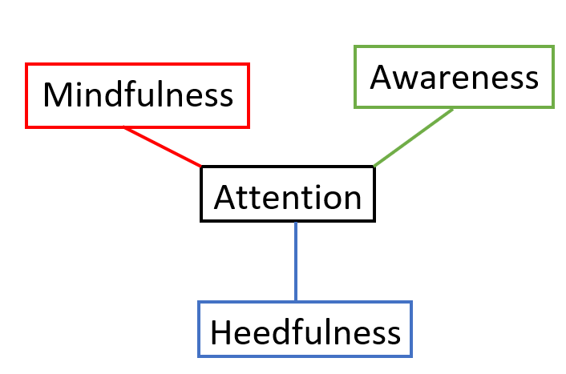
What is Attention and What is it For?
What do we mean when we say “pay attention”?
What are things on the outside that we can pay attention to? What do we use?
What are things on the inside we can pay attention to? What do we use?
Why is it important to pay attention to these things?
What might happen if we couldn’t pay attention at all?

Slide 4

The Story of Ben
Imagine a time when you did something without thinking about how it could harm you.
What happened in this story? What did Ben do without thinking about it? What was Ben careful about, did it work?
Brainstorm a list of things it’s good to be careful about

Slide 5
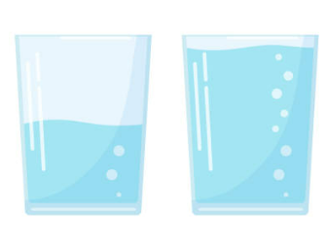
Pass the Cup
Did you notice any moments when you lost your attention, when your attention went to something else? What distracted you?
How were you able to practice mindfulness by keeping your attention on the cup? What helped you pay attention?Who was practicing heedfulness by trying not to spill the cup? Raise your hand.
Were you able to bring your mind back to the cup if you lost your attention?
Name some other times when you pay close attention like this

Slide 6
Debrief
"What did you notice this time, when we paid attention to our resource a bit longer?
Were you able to pay attention?
What did you do when you lost your attention or got distracted?
Is it getting easier or harder to pay attention as we practice? Do you notice any changes?
Do you notice any difference in the class as a whole when we practice?"

