Slide 1
Strengthening Attention & Self-Awareness
Learning Experience: Exploring Attention

Slide 2
Checking In

Slide 3
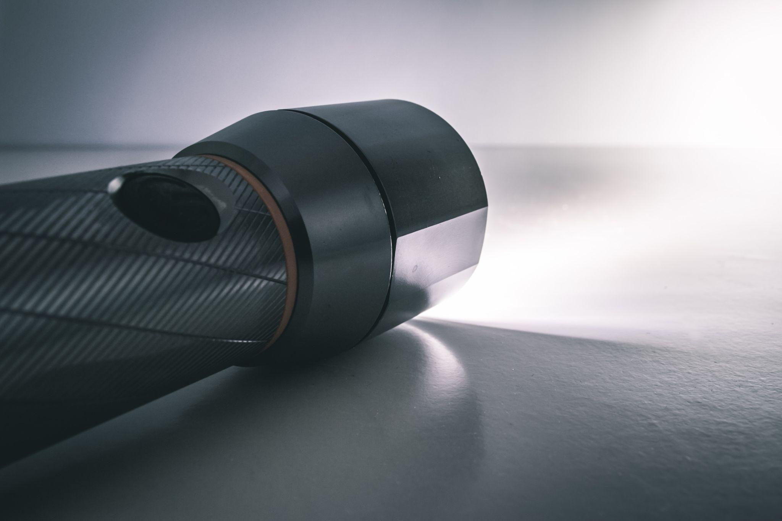
Attention with a Flashlight
What do the objects or the room look like in the dark?
How about when the flashlight shines on the area?
Notes:
Used free stock image

Slide 4
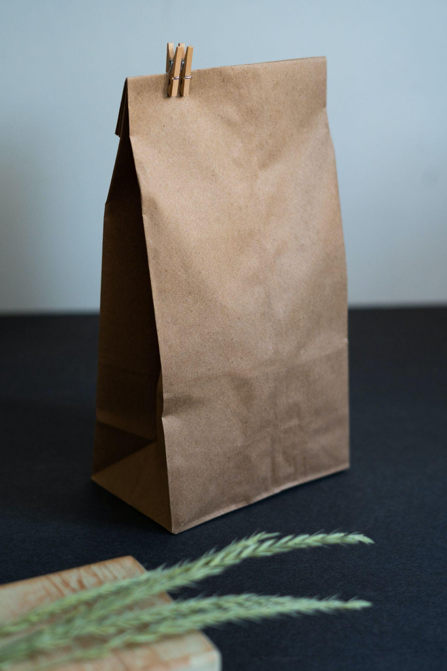
I Notice, I Wonder
Pass around the object, and if you know what it is, don’t tell anyone.
Play close attention and observe.
What is one thing you notice or wonder?
Notes:
Used free stock image

Slide 5

Settling the Mind with a Resource
Let’s practice strengthening our attention! Hold your attention a little bit longer with a resource.
What did you notice this time?
Were you able to pay attention?
How else might it help us if we practice attention and get better at it?
Notes:
Used free stock image

Slide 6
Debrief
Have you learned anything about attention that you found interesting?
How else might it help us if we practice attention and get better at it?

