Slide 1
Exploring the Mind
Chapter 3 Learning Experience 1

Slide 2
Check-In
“Let’s start with some resourcing. If you like you can take out a resource from your treasure chest or you can just imagine your resource.
If someone did something kind for you recently, or if you were kind to someone else, you can feel free to use that as your resource.
If you’d rather do grounding, you can find a comfortable way to sit or something comfortable to hold or touch.
Let’s now take a few moments to think about our resources or pay attention to our grounding. [Pause.]
Now let’s do tracking and pay attention to the sensations inside our bodies.
If you find a pleasant or neutral sensation just pay attention to that and watch it. See if it changes or stays the same. [Pause.]
If you haven’t found a pleasant or neutral sensation, see if you can shift to another part of your body to find a place that feels better. [Pause.]

Slide 3
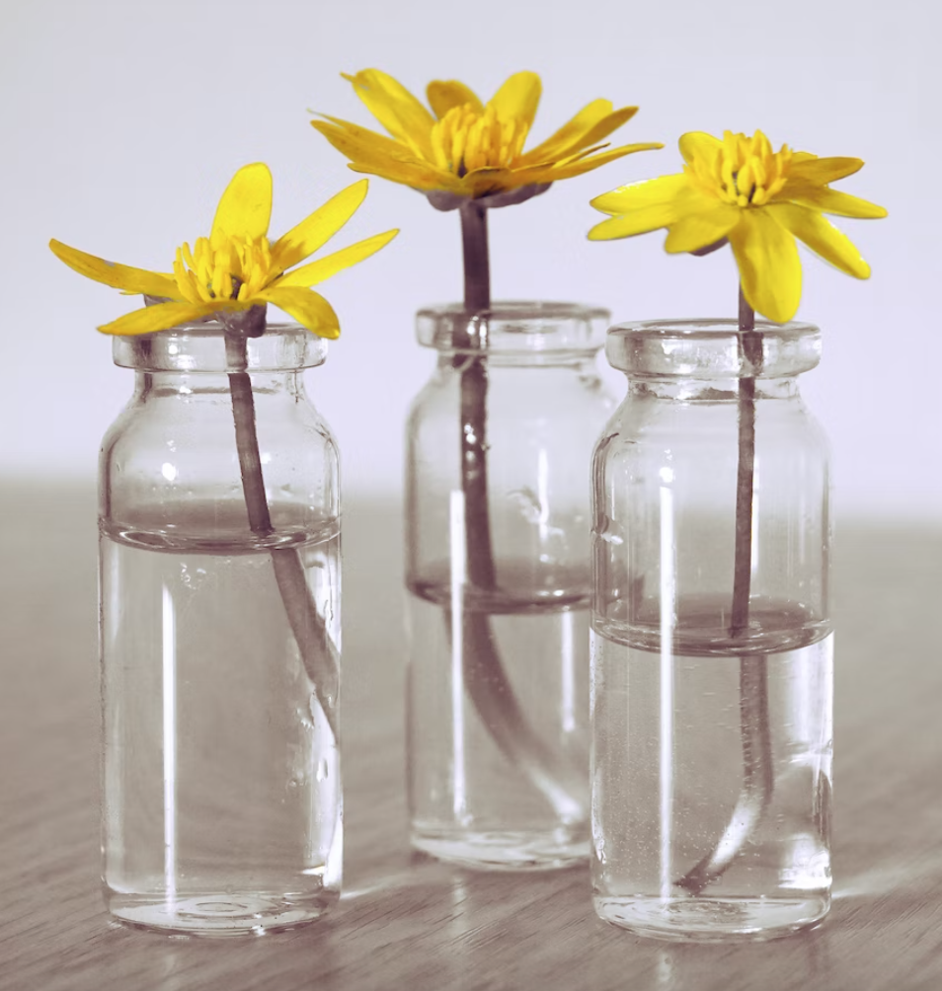
Insight Activity - The Mind Jar
The jar represents Desmond’s mind
Can you see clearly through it?
Our code
Sand = neutral things
Pebbles = challenging things
Glitter = nice things

Slide 4
Debrief
How did Desmond feel at the beginning, middle and end?
What was challenging for him?
What was neutral for him?
What was pleasant for him?
What do we mean when we use the word “mind”?
What are some of the things that take place in our mind that we can’t see with our senses?

Slide 5
Insight Activity - Settling the Mind
What do you notice in your body as we just watch the jar settle and keep our attention on it?
Notice how the mind jar just slowly settles and becomes clearer when no one is stirring it or disturbing it.

Slide 6
Debrief
What did you notice (in your mind or body) as you watched the jar settle?
Did anyone have a strategy that helped you stay focused on the Mind Jar?
Do you think it helps us if our minds are calmer and more settled? What does it help us do?

