Slide 1
Building Resilience
Learning Experience: Exploring Sensations

Slide 2
Checking In

Slide 3
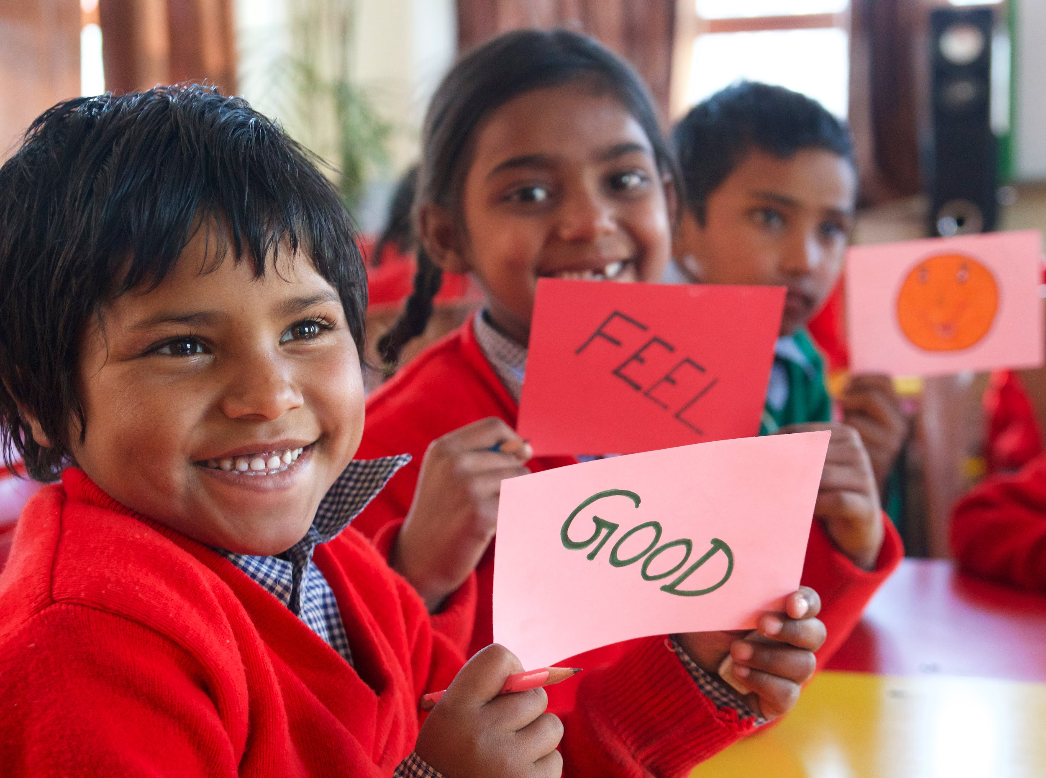
What are sensations?
Think of things you can sense on the outside.
Now, think of things you can sense on the inside.

Slide 4
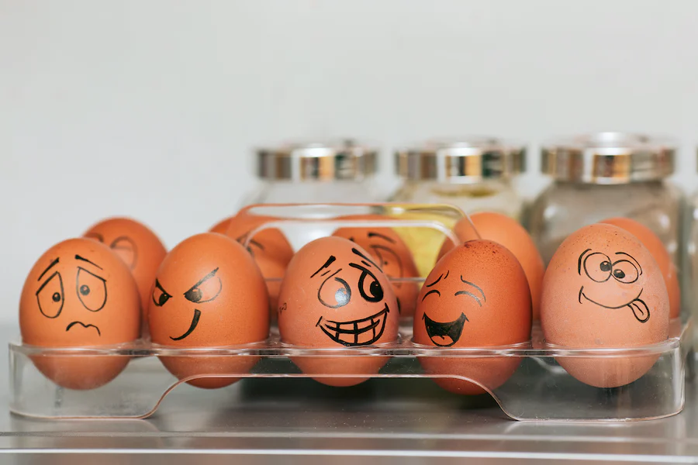
Sensing on the Outside and Inside
Listen and raise your hand when you have 3 things you heard in the room.
Look around the room for something red.
Did you feel any sensations in your body when you did this?

Slide 5
Debrief
What are some things you learned today about sensations?
What are some words that describe sensations?
How can knowing a little more about the idea of sensations help us be happier and kinder? When do you think it might be useful to use one of these “Help Now!” activities?

