Slide 1
How Kindness and Safety Affect the Body
Chapter 2 Learning Experience 7

Slide 2
Check-In
“Let’s take out our treasure chests and see if there’s something in there we’d like to use, Or if you’d rather do grounding, you can find a comfortable way to sit, stand or lean.
If you’re resourcing, then pick one of your personal resources and hold it in your hands or place it in front of you. Let your eyes rest on it, or close your eyes and feel it carefully with your hands.
If you’re grounding, just bring your attention to your body.
Let’s now take a few moments to do tracking and pay attention to the sensations inside our bodies. [Pause.]
If you find a pleasant or neutral sensation just pay attention to that and watch it. See if it changes or stays the same.
If you haven’t found a pleasant or neutral sensation, see if you can shift to another part of your body to find a place that feels better. [Pause.]
What did you notice?”

Slide 3
Discussion -

Slide 4
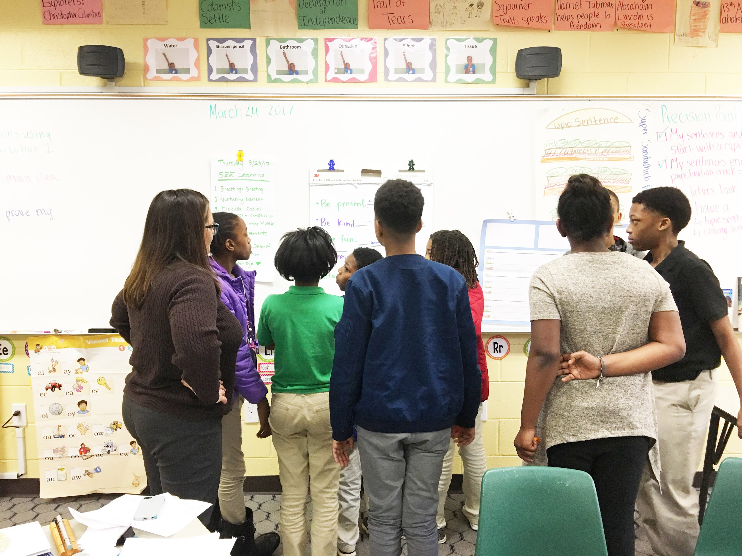
Insight Activity - Acting Out the Class Agreements with Tracking
Create a story based on class agreements and helping action being followed or broken.
Act the story out.
What are some of the feelings that the characters in the story may be feeling? Do you know what zone they are in?
What did you see? How did it make you feel?

Slide 5
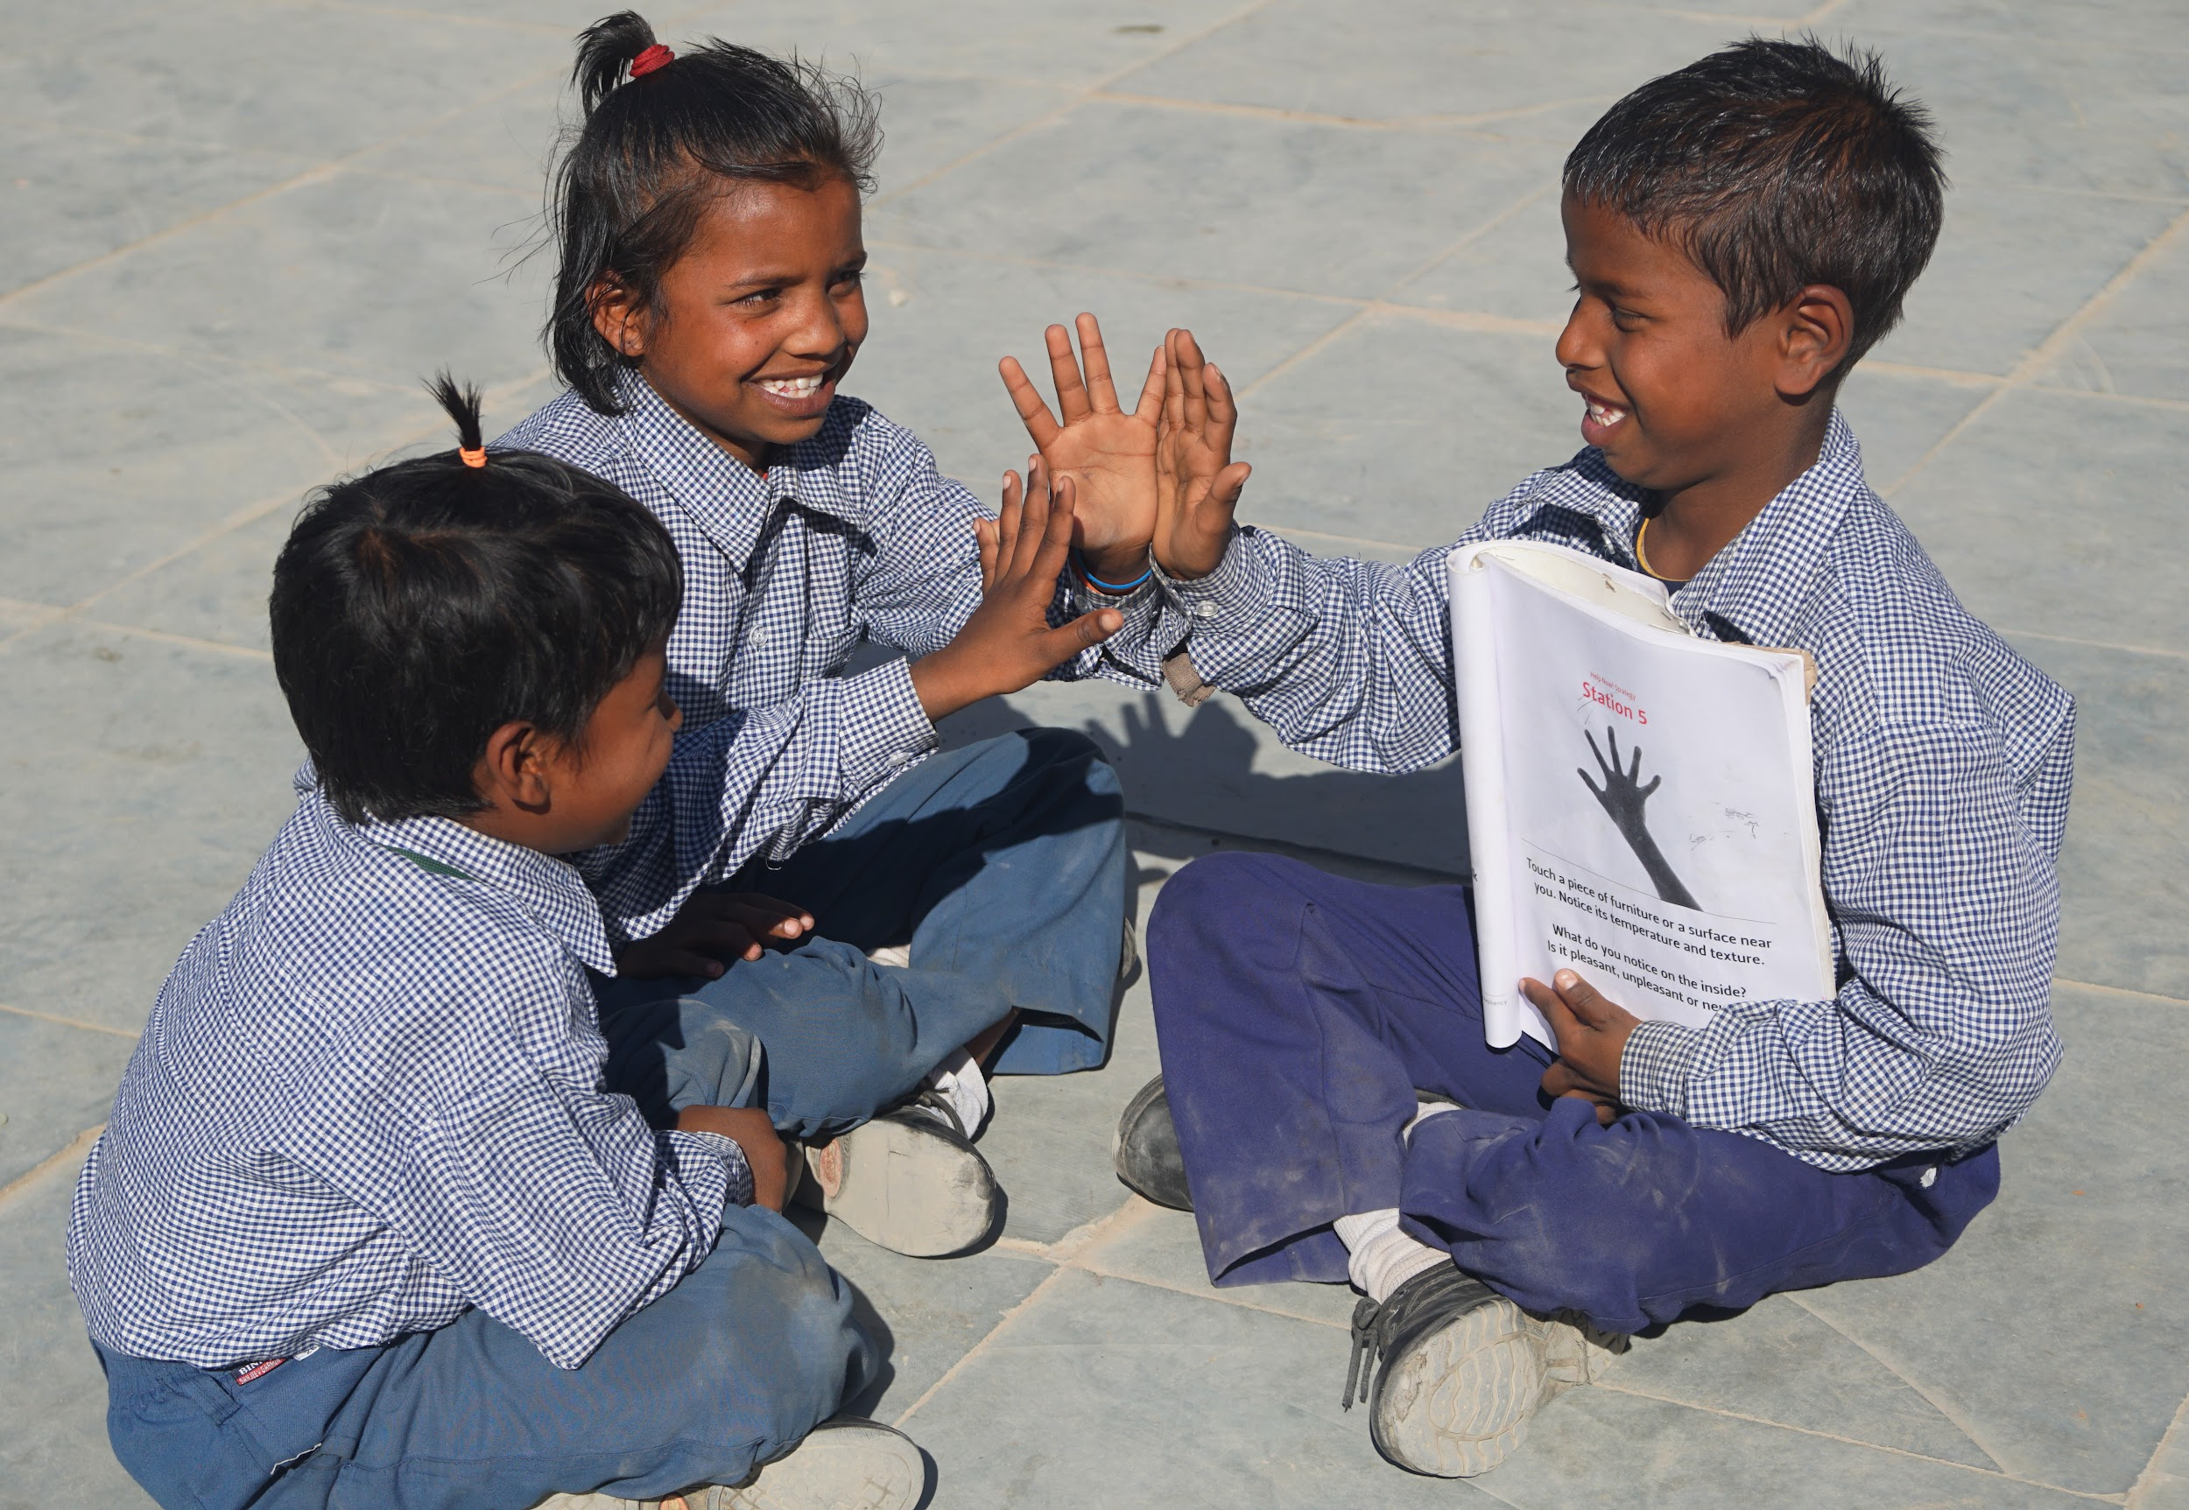
Debrief
What did you learn today about our class agreements?
How do our class agreements affect our bodies?
Is happiness something we feel inside the body? How do we know that? What about kindness?
Is there anything you think we should add to the class agreements after what we did today?
Is there anything you learned or practiced about kindness that you might like to use again sometime?

