Slide 1
Building Resilience
Learning Experience: Nelson and the Resilient Zone

Slide 2
Check In

Slide 3
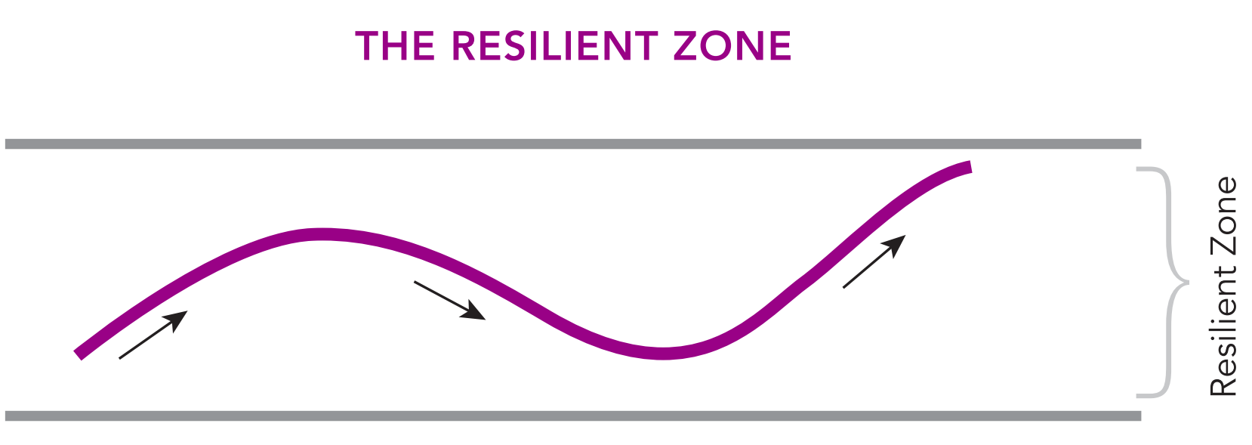
The Resilient Zone
How do you think Nelson feels in his resilient zone?

Slide 4
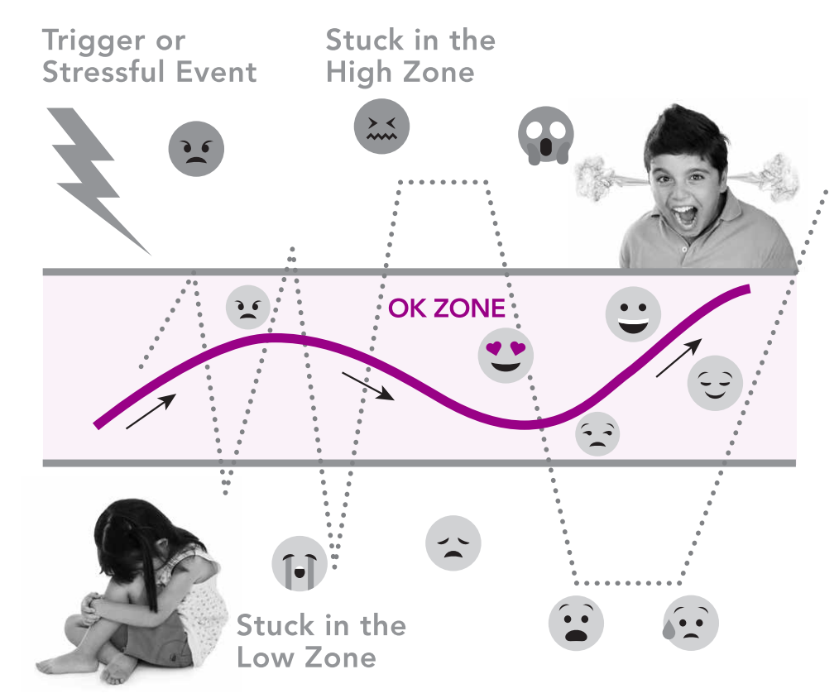
The Resilient Zone Continued
How do you think Nelson feels in his high zone?
How do you think Nelson feels in his low zone?

Slide 5
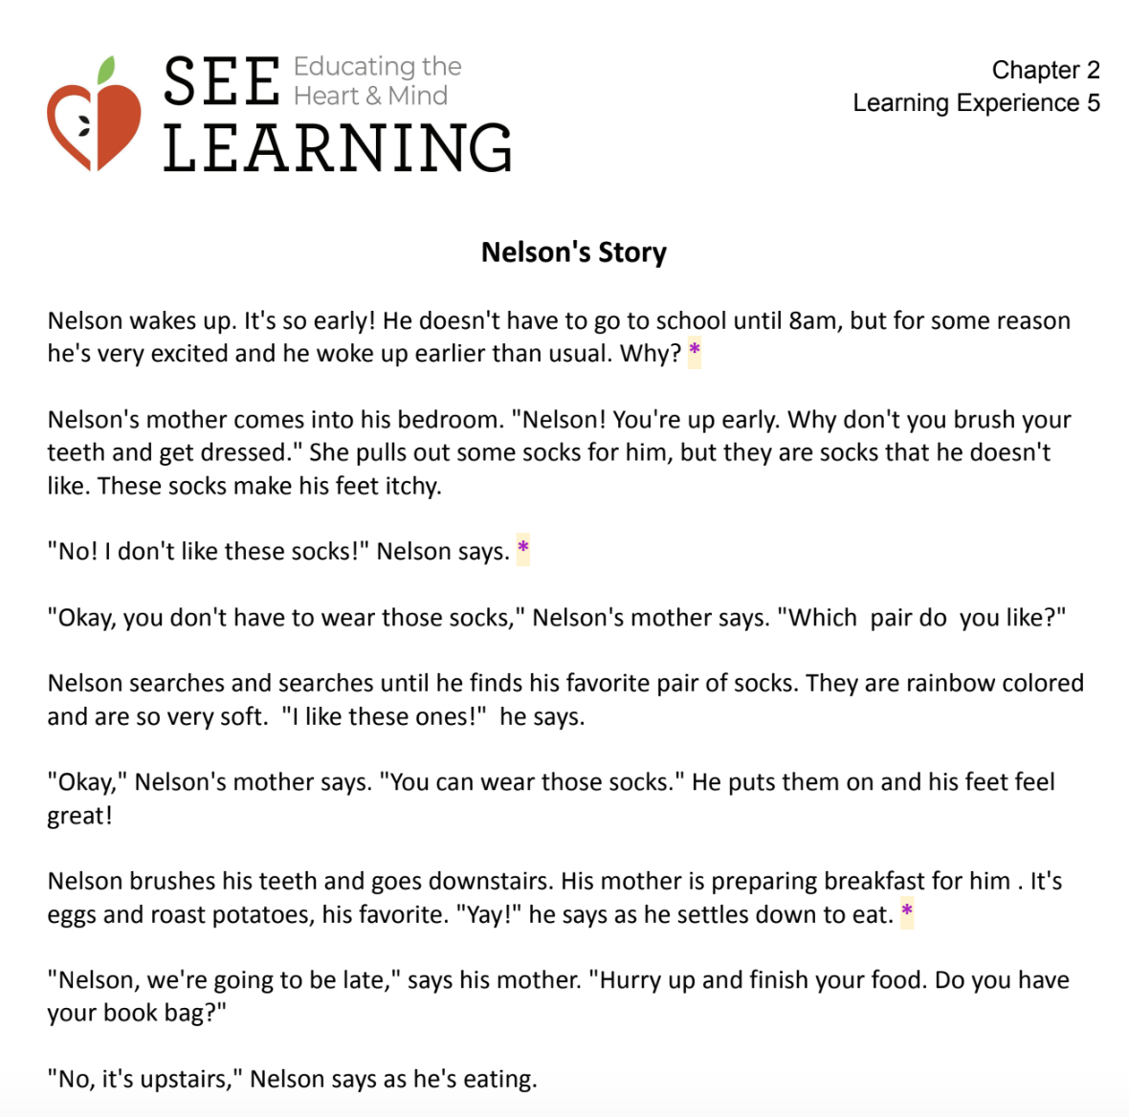
Nelson’s Day
For each asterisk (*) in the handout…
What sensations do you think Nelson is feeling right now in his body?
Where is Nelson in his three zones?

Slide 6
Debrief
Can anyone explain the drawing of the resilient zone?
How do you think we'd know if someone else was in their high zone? What about their low zone?
Are there other words we could use to explain resilience?
Do you think most people have been stuck in the high zone some time? What about the low zone?
What did you learn today that you want to remember because you feel it might be helpful sometime?

