Slide 1
Grounding
Chapter 2 Learning Experience 4

Slide 2
Check-In
Take out treasure chests.
Pick a personal resource and hold it or place it in front of you.
Look or feel it carefully with hands.
Give attention to object and notice sensations inside the body.
Be curious about any sensations, or enjoy the object if no sensations are noticed.

Slide 3
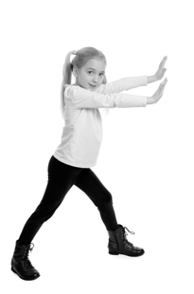
Insight Activity - Grounding with One’s Stance
Let’s practice different ways to move our body (like pushing against the wall). Then, we can decide which movements make us feel comfortable.

Slide 4
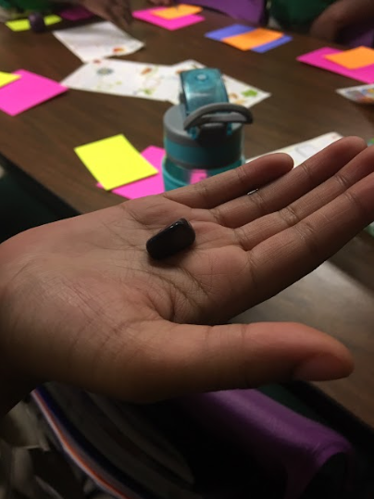
Insight Activity - Grounding with an Object
Let’s choose some objects to hold and see how they makes us feel.

Slide 5
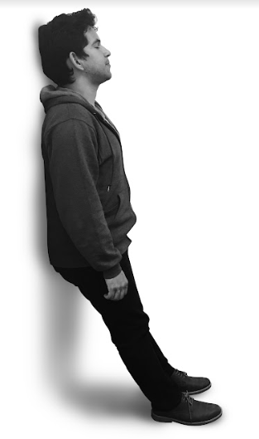
Insight Activity - Grounding with a Part of the Body
Let’s move our bodies into different positions like standing and leaning on the wall. Think about how your hands and feet feel when you do these motions.

Slide 6
Debrief
We have spent some time together trying out different ways of grounding ourselves and noticing sensations within our bodies.
Which has been the best one for you (i.e. which has given you pleasant or neutral sensations)?
Which one did not work for you?
Does anyone remember a sensation that they felt or heard someone else share?
When do you think you could use grounding?

