Slide 1
Creating a Treasure Chest
Chapter 2 Learning Experience 3

Slide 2
Check-In
Get comfortable and take out kindness drawings from a few days ago.
Look around the room and focus on something pleasant or neutral.
Bring attention to a pleasant or neutral place on the inside.
Think about the moment of kindness or resource from the drawing.
Notice sensations in the body, stay with pleasant or neutral, shift or choose Help Now! activities if unpleasant.
Learn about our bodies and how to calm them.

Slide 3

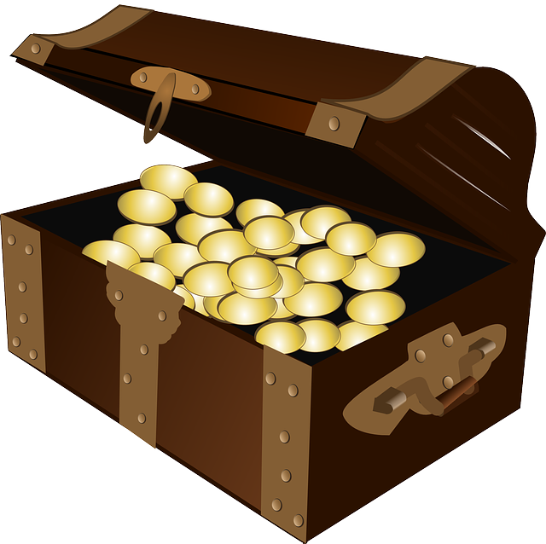
Insight Activity - Creating a Treasure Chest of Personal Resources
What do you think a personal resource is?
Share some of your personal resources!

Slide 4
Reflective Practice - Practicing Resourcing and Tracking
Choose one of your personal resources and sit with it!
Can you notice sensations in the body and say if they’re pleasant, unpleasant, or neutral?

Slide 5
Debrief
These treasure chests are for you to use to help you whenever you need to feel more safe, calm, and peaceful.
What kinds of sensations came when we looked at our personal resources?
Do you think we could come up with more personal resources in the future?
When might you want to use your treasure chest?

Slide 6
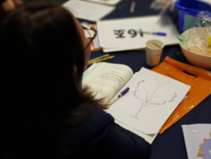
Resource Stone
Take a moment and think of something that you are thankful for.
Picture it in your mind.
How do you feel? Let’s go around the circle and share.

