Slide 1
Class Agreements
Chapter 1 Learning Experience 2

Slide 2
Check-In
Last time we learned about kindness and
happiness. We played the step in, step out game and we also drew a moment when someone was kind to us.
Does anybody remember some of the things we talked about?
What do you remember? What can you tell me about kindness and happiness?
Does it help us be happy when other people are kind to us?
Let’s remember our kindness drawing from last time (or a new one) for a moment. Do you notice your body or feelings change? How do you feel different?

Slide 3
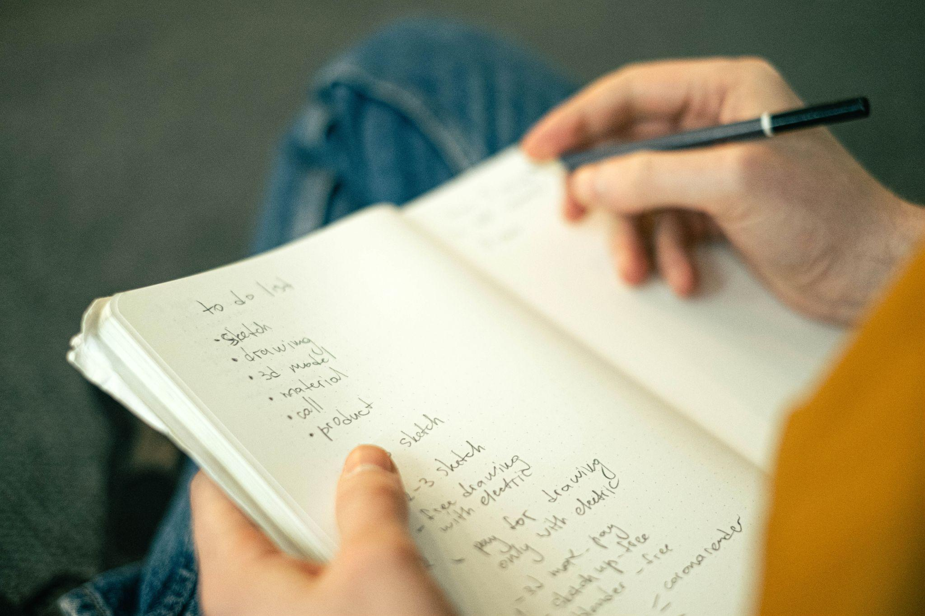
Insight Activity - Creating Classroom Agreements
Let’s make a list of how we would like our class to be! What do we agree on as a class to be happy and have a safe, caring classroom?

Slide 4
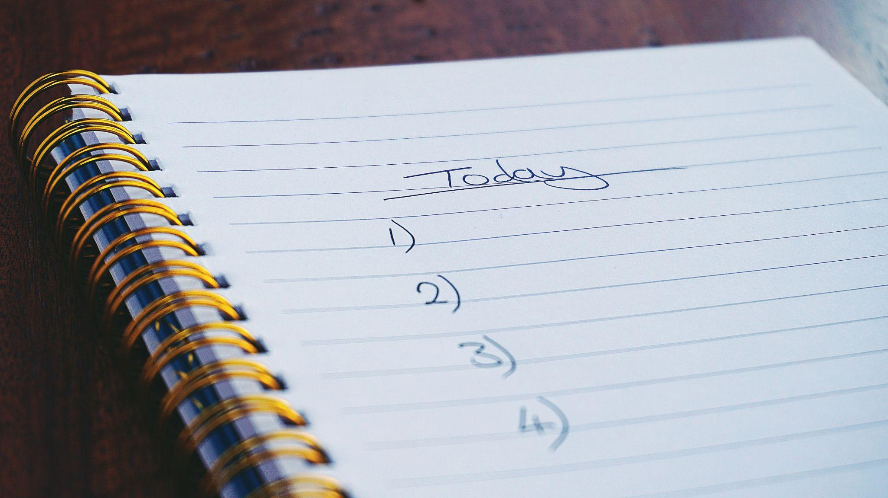
Insight Activity - Creating Classroom Agreements
Let’s look back to the list we came up with. Should we add anything?
Let’s put them in the form, “Be kind…”
Apply this to the classroom!

Slide 5
Debrief
We will learn about how best to be kind to ourselves and others.
This agreement that we created together is the first step!
In one word or sentence, is there anything you learned today that you might use another time to help yourself or someone else meet their needs?”
Share out loud or write in your journals!

