Slide 1
Practicing Kindness
Chapter 1 Learning Experience 3

Slide 2
Check-In
Let’s take a moment to sit quietly and rest our minds and bodies so that we can think a bit. Maybe you are tired or full of energy, maybe it’s been a challenging morning (day) or an exciting one. Either way, it’s okay.
Now let’s all see if we can think of any moments of kindness in the day so far. Maybe something happened at home or on your way to school or as recently as just a minute ago. See what comes up for you. Don’t worry if you can’t think of something, you can always imagine a moment of kindness too.
Let’s sit with your moment of kindness for a little bit.
Would anyone like to share what they thought of?
How did that make you feel?

Slide 3
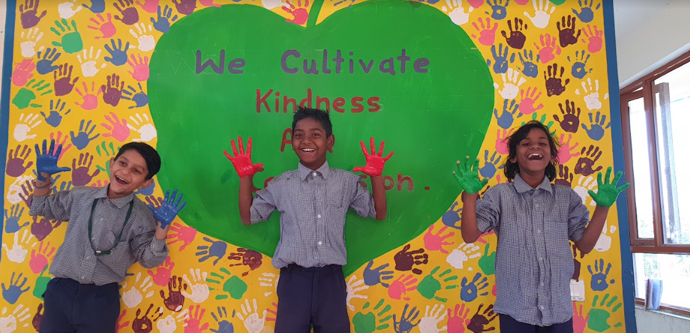
Insight Activity - Turning Class Agreements into Helping Actions
What does it look like when we follow our class agreements? How does it make you feel? What does it sound like? Draw or write this on a piece of paper.

Slide 4
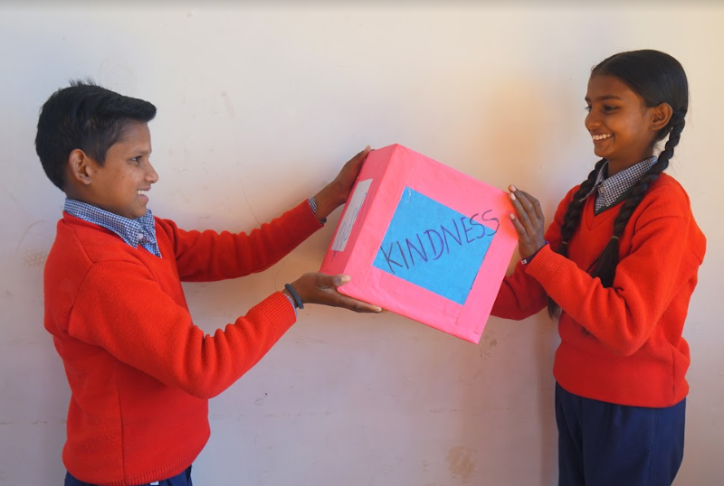
Reflective Practice - Practice and Acting Out Kindness
Now, let’s pretend that one of us needs help. Let’s also pretend that 2 of our classmates are helpers. What helping actions can we practice? How does the person being helped feel? How do our helpers feel? How does everyone watching feel?

Slide 5
Debrief
Did you notice how you felt when you saw people needing help or getting help?
Is there anything you learned or practiced about kindness that you might like to use again sometime?
Is there anything you think we should add to the class agreements after what we did today?

